Slide 1
AWS Server Administration Guide

Slide 2
AWS Server – Starting and stopping

Slide 3
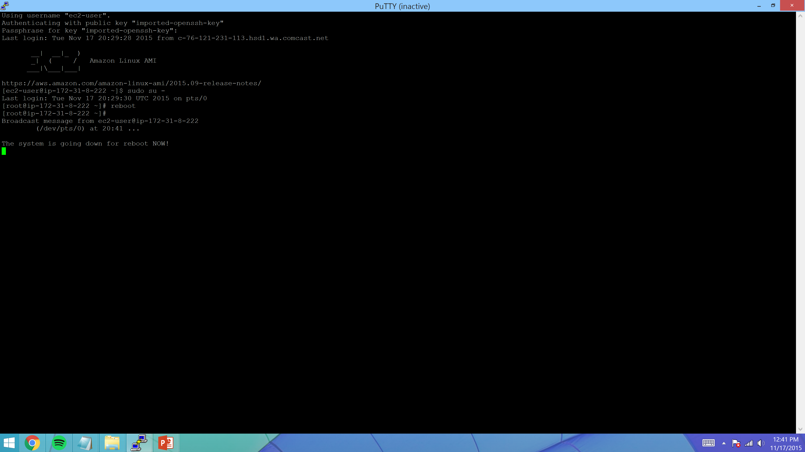
To Reboot the Server from a Unix Session – Login to putty and sudo to root. Then type “reboot” to restart the server. Or execute the “shutdown now” command to stop the Server.

Slide 4
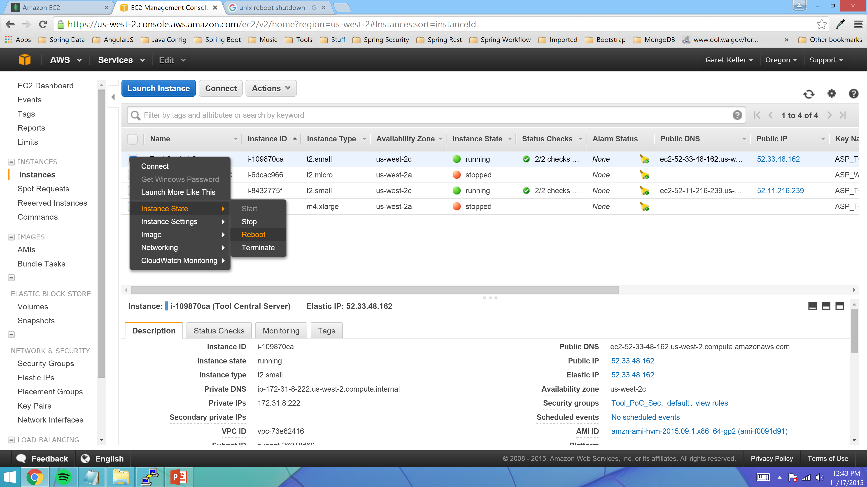
To Reboot the Server from the AWS Console first login to AWS. Then Navigate to the “Instances” page. And from here right click the Server you want to work with and then select an operation to perform.

Slide 5
AWS Server Administration Scripts

Slide 6
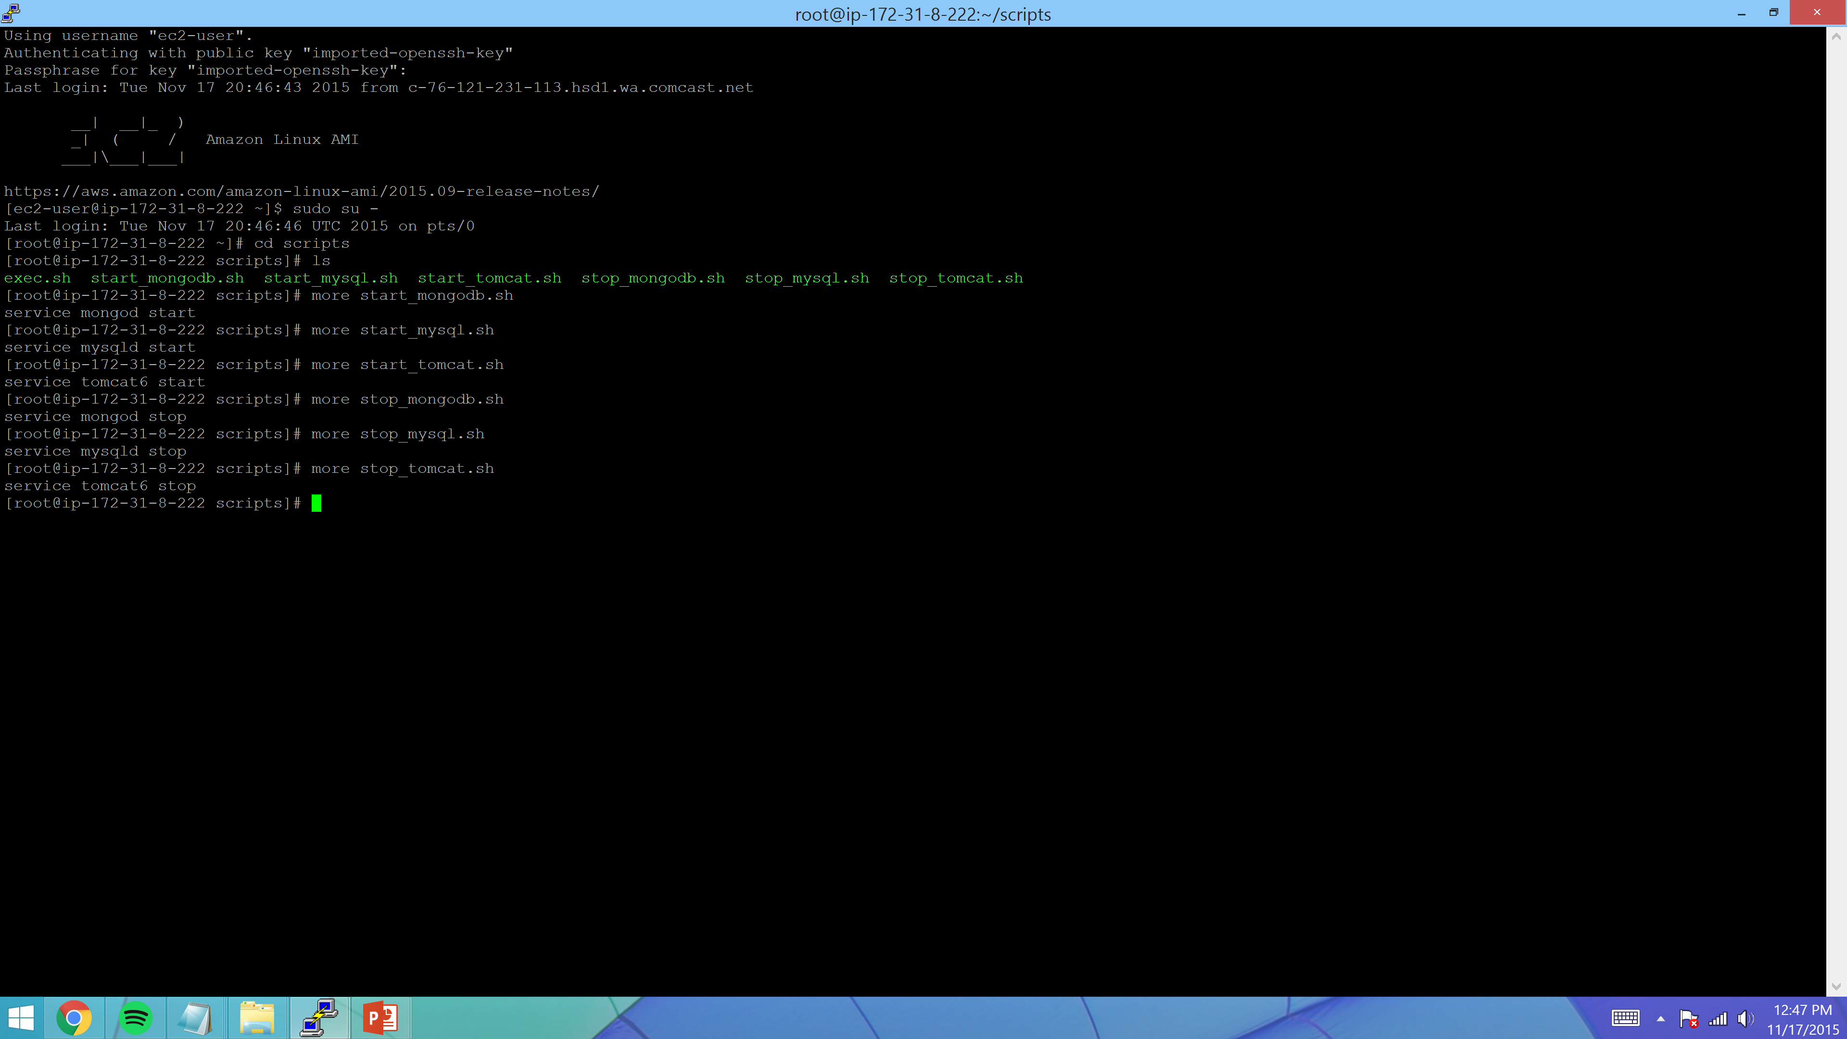
Login to a Unix session as the root user and navigate to the scripts directory. Here are the scripts to manually stop and start each of the separate services independent of reboot.

Slide 7
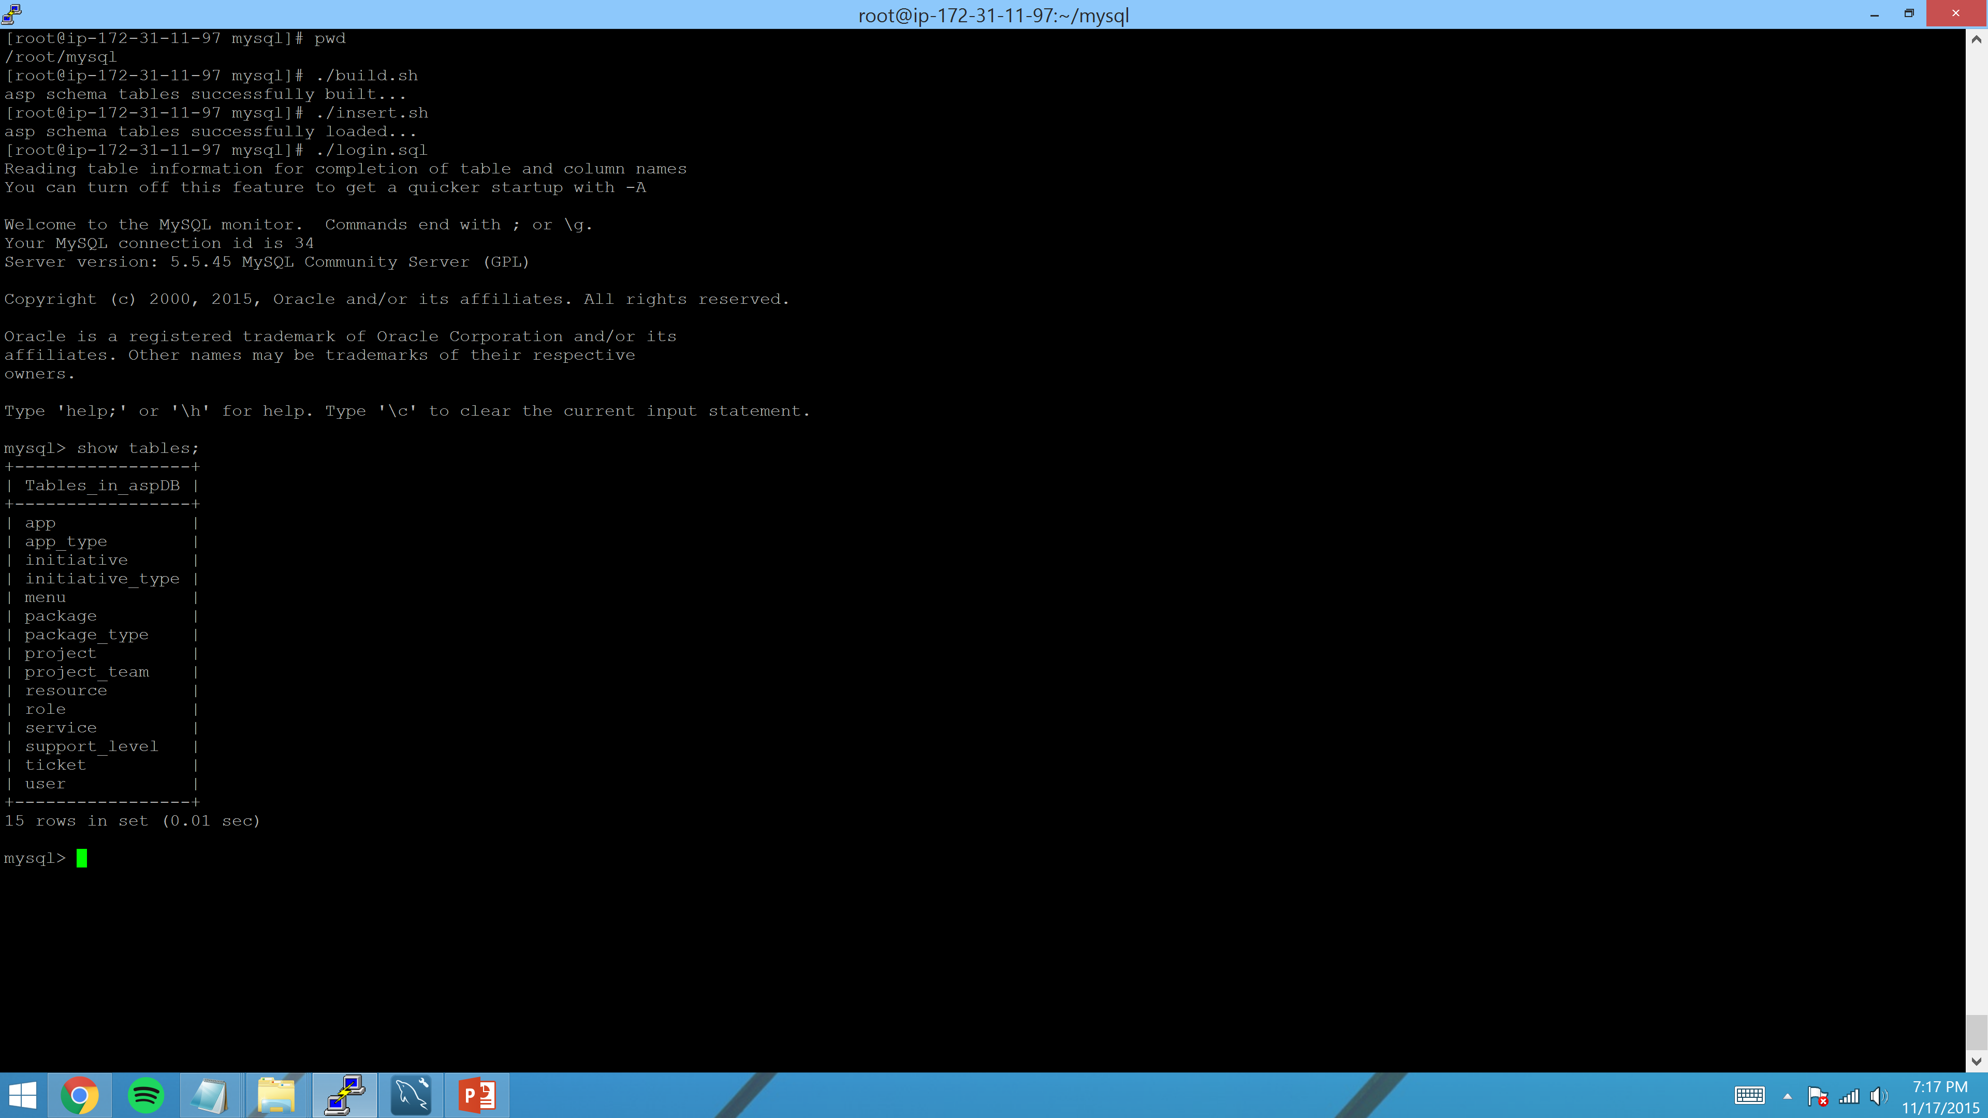
Login to a Unix session as the root user and navigate to the mysql directory. Here are the scripts to rebuild the asp schema from scratch and then populate it with default values.

Slide 8
AWS Server Log Rotation

